Slide 1
How to deploy a project to the cloud (APP engine - not basic GCP)
Ashish Jain
https://www.youtube.com/watch?v=ZGn5ahF6Bv0

Slide 2
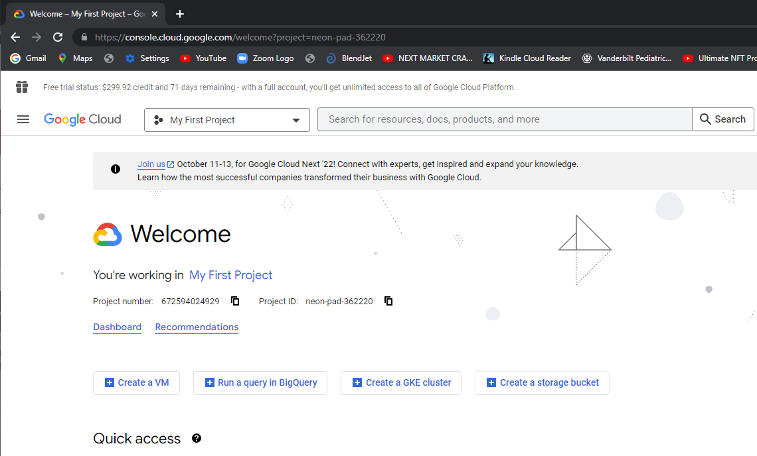

Slide 4
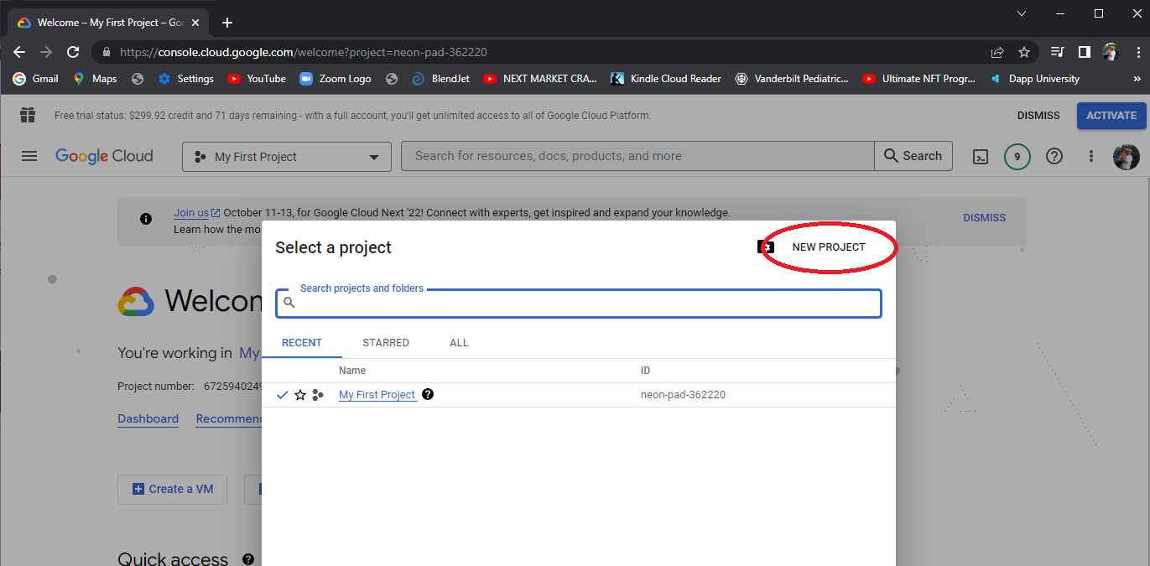

Slide 5
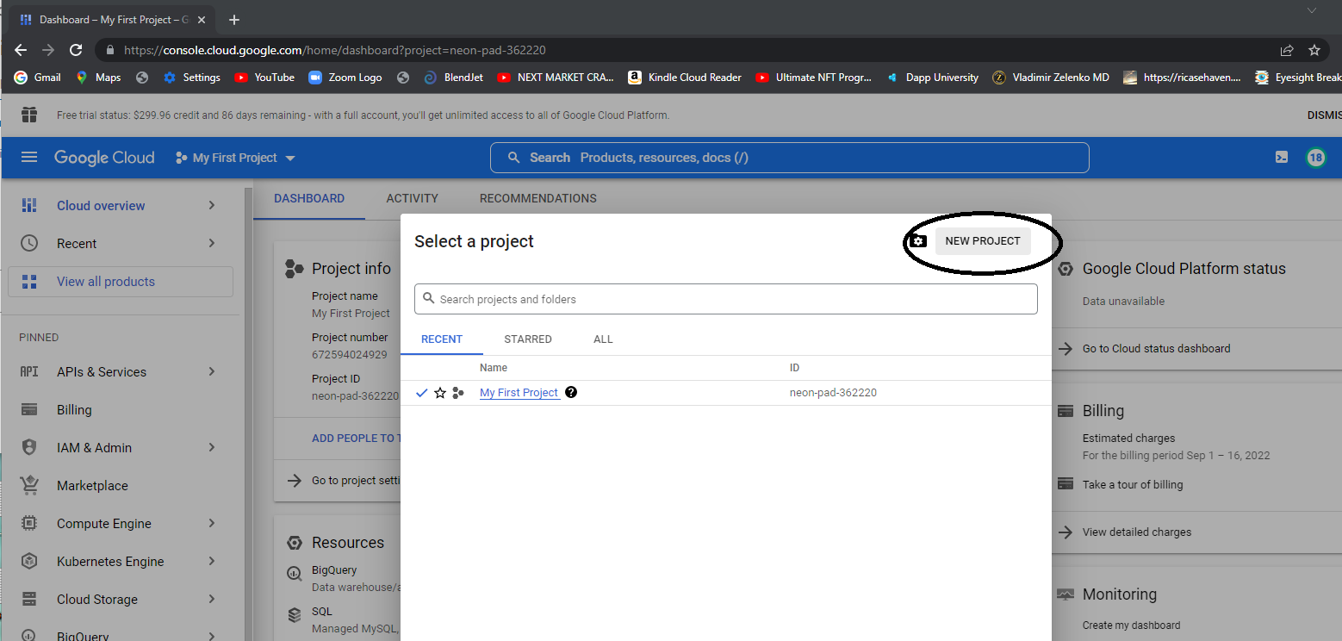

Slide 6
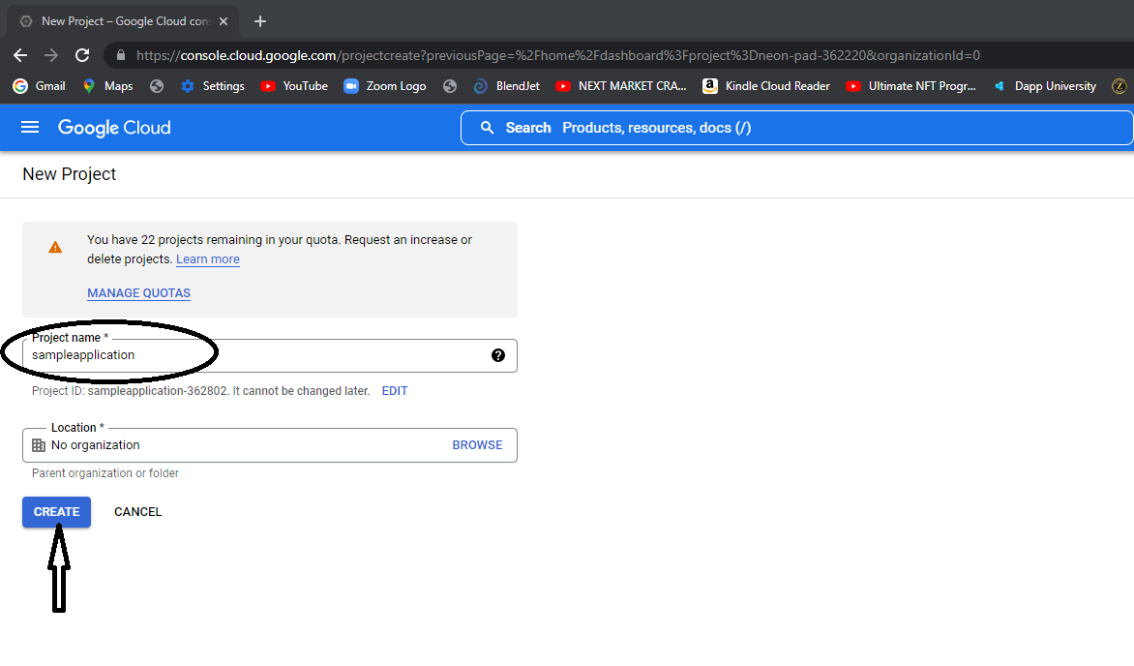

Slide 7
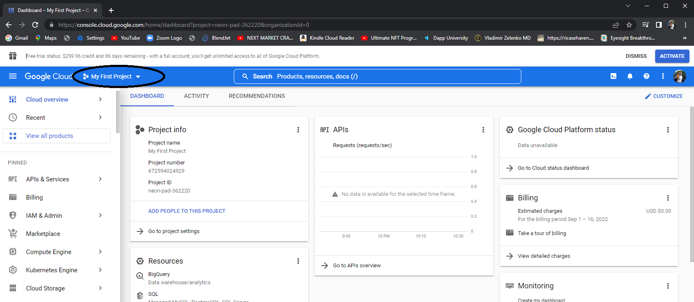

Slide 8
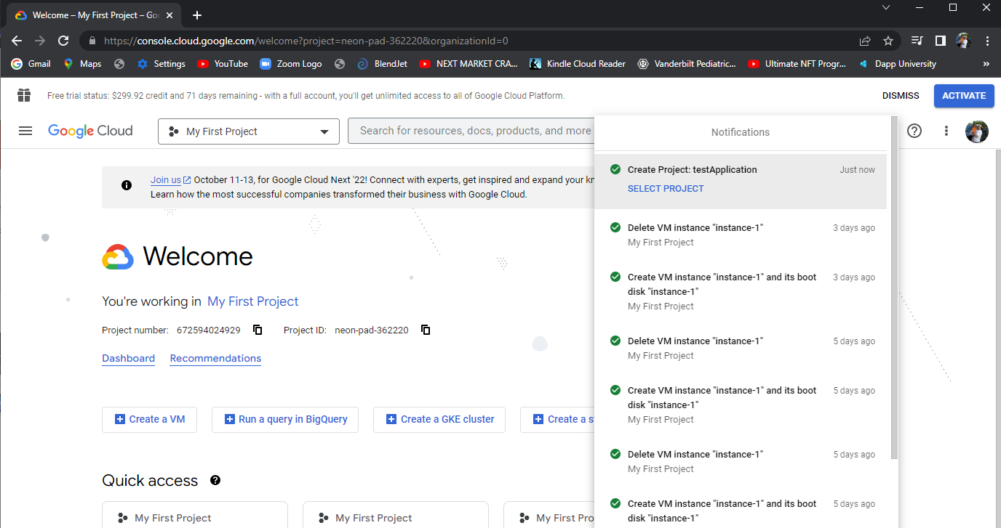
Monitor notifications to see when your project has completed.

Slide 9
Now you will want to open a “cloudshell” terminal
If it is not readily available you can search for “Cloud shell” in the search box.
Then obtain the list
gcloud projects list

Slide 10
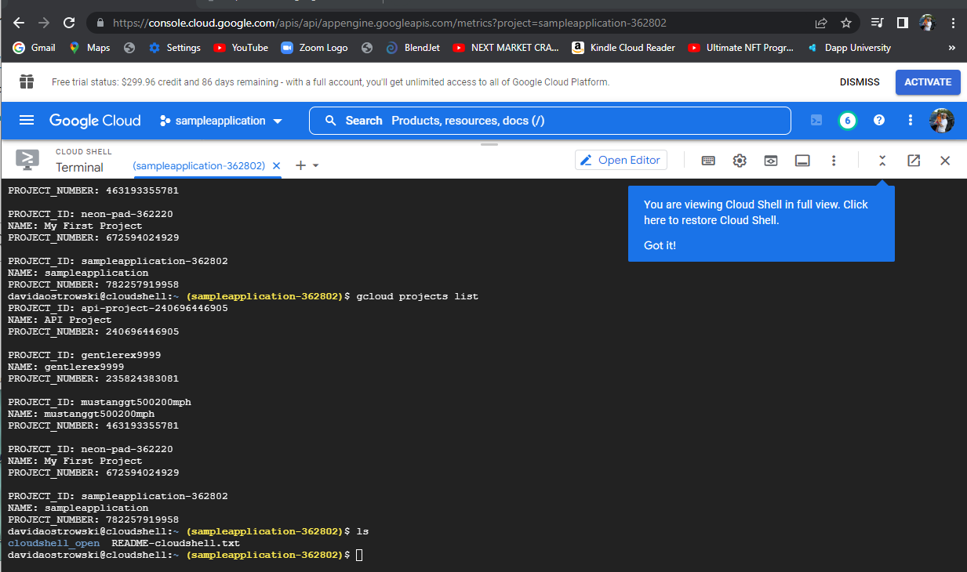

Slide 11
If it hasn’t already been assigned then you can perform a
Gcloud config set project <project_name>-<ProjectNumber>

Slide 12
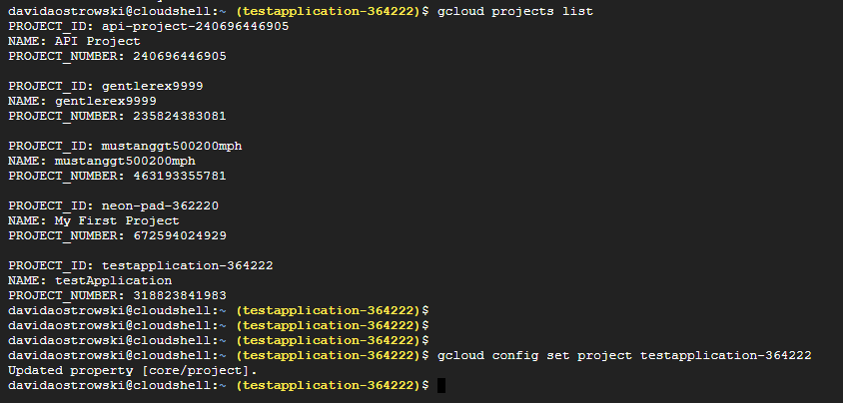

Slide 13
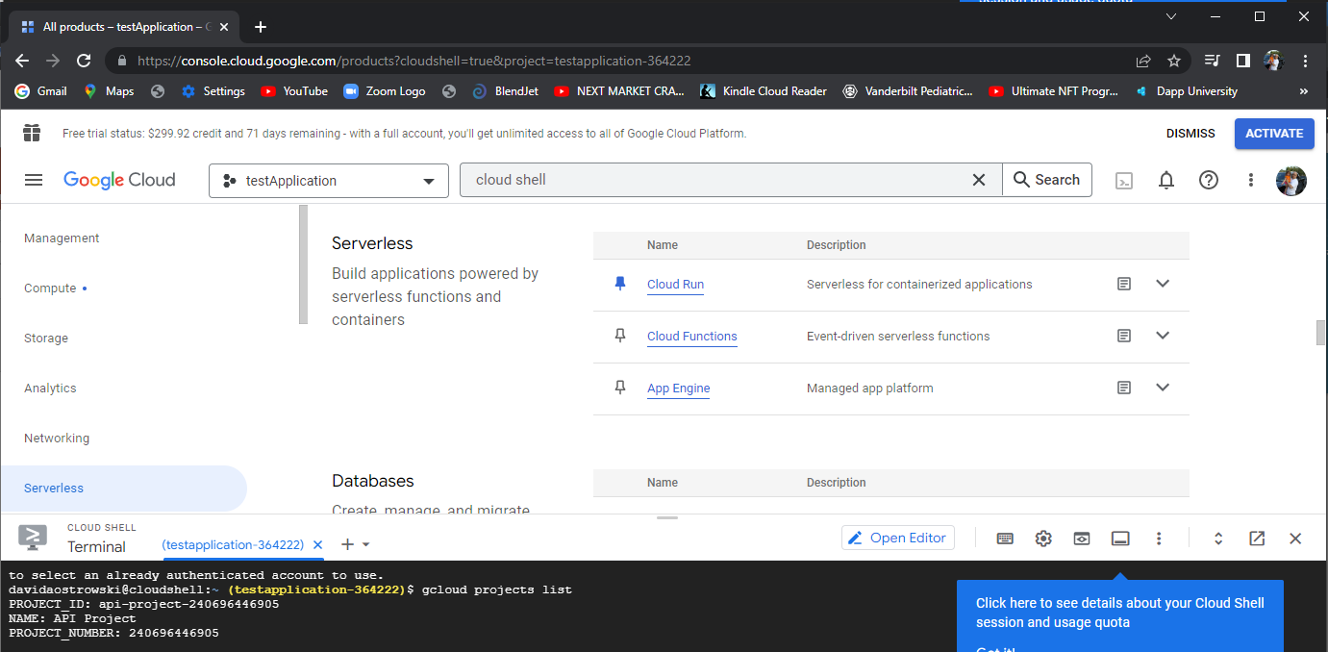
Back to the console to create your “App Engine” application

Slide 14
I can create an application one of two ways
Click “app engine” => create
Or from the cloud terminal
Gcloud app create

Slide 15
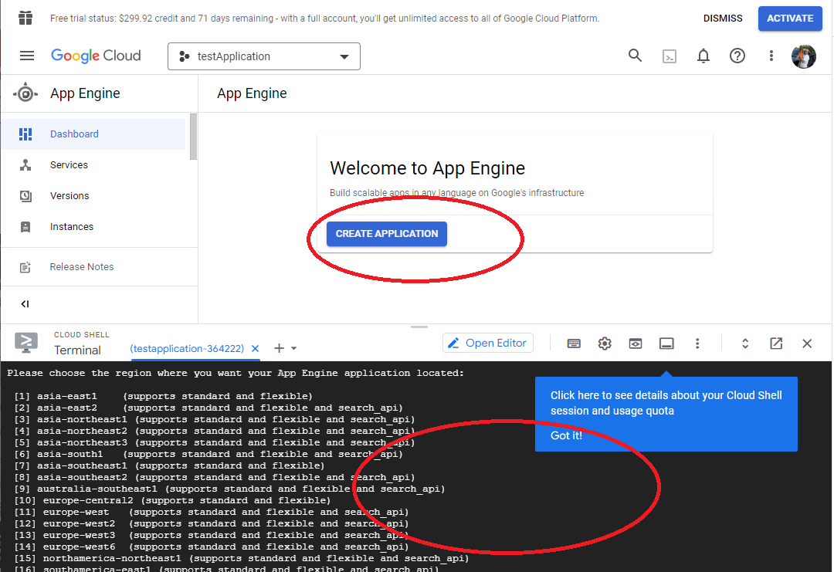

Slide 16
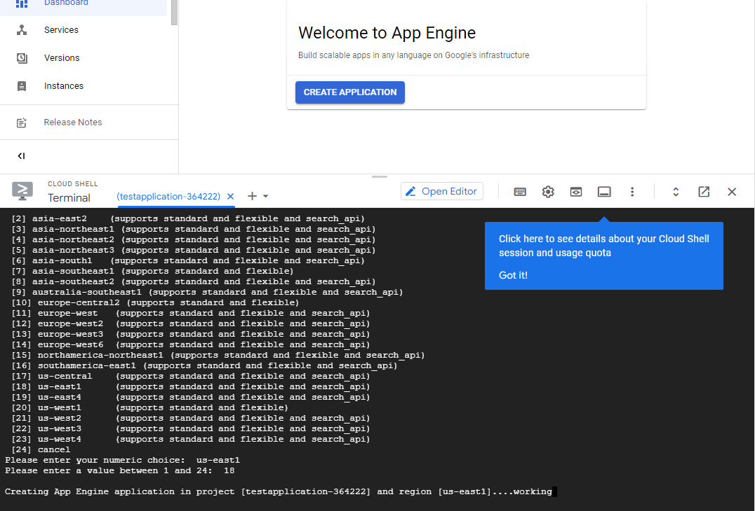

Slide 17
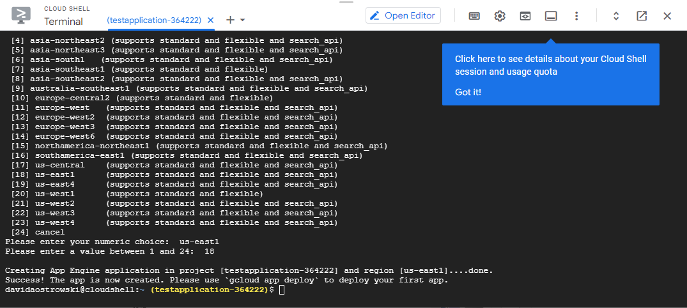

Slide 18
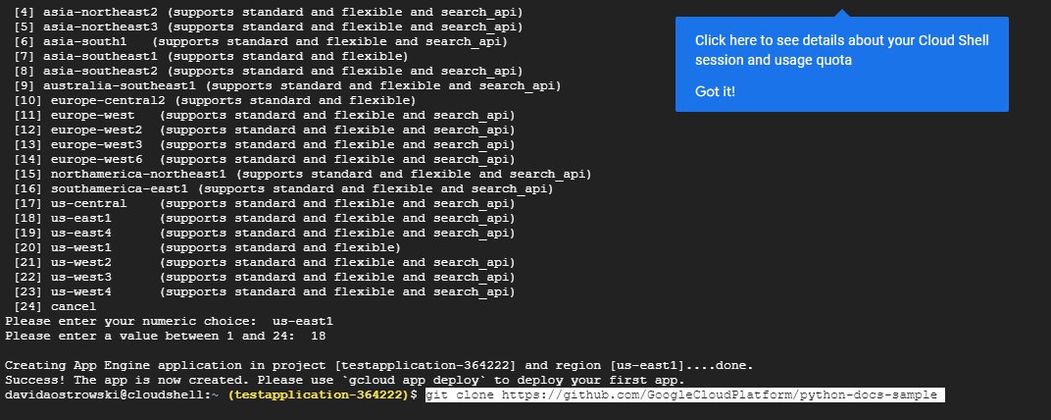

Slide 19
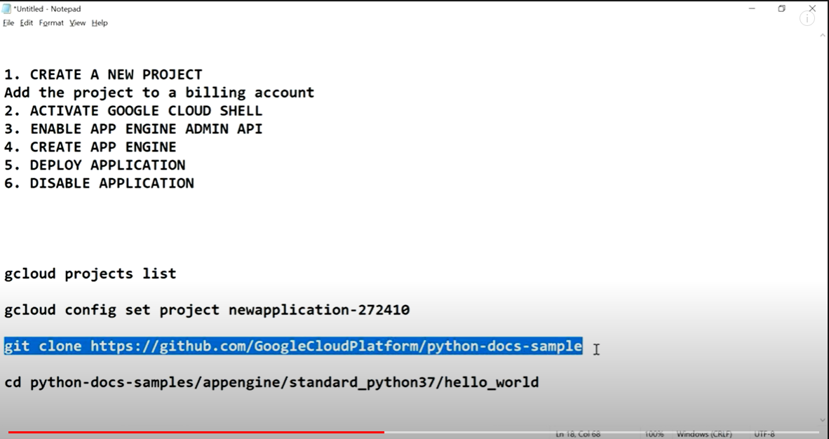

Slide 20
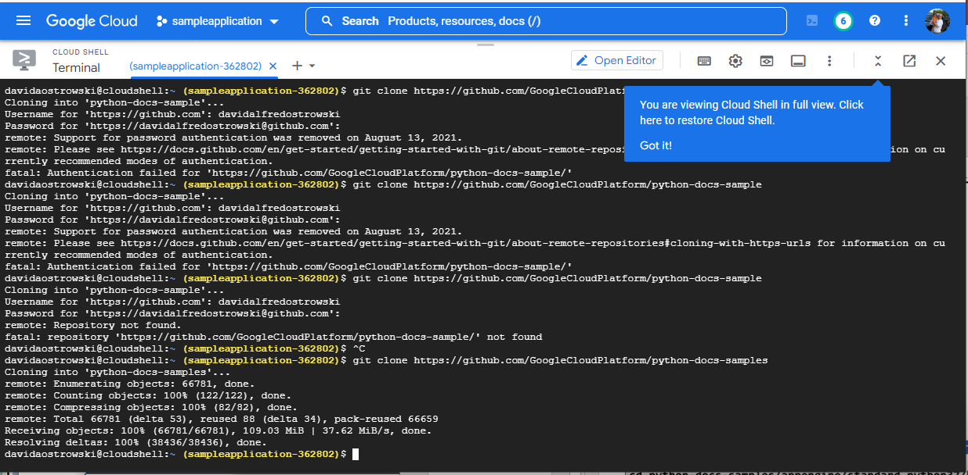
I had to generate a new token “personal access token” to get this to load.

Slide 21
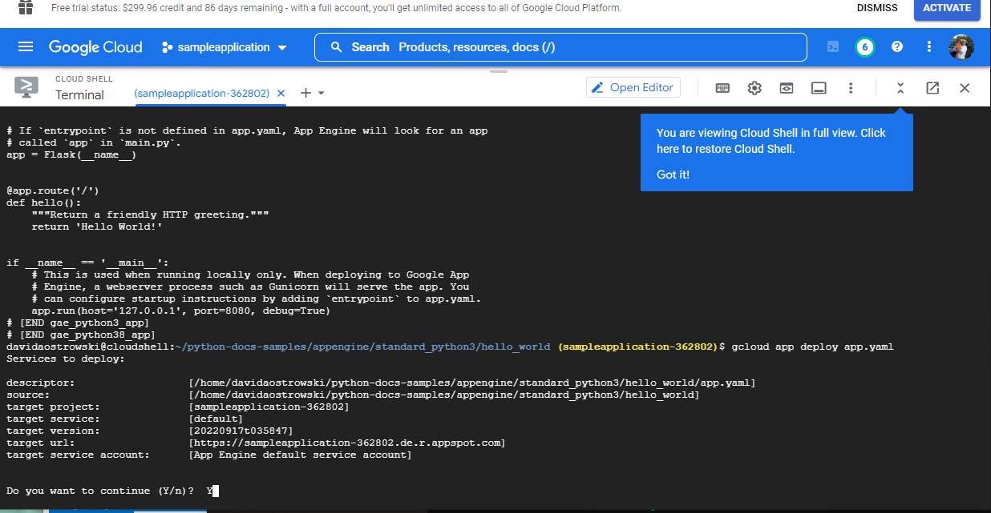
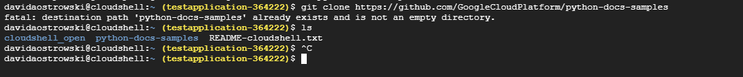

Slide 23
Had to generate a personal access token instead of a password.

Slide 24
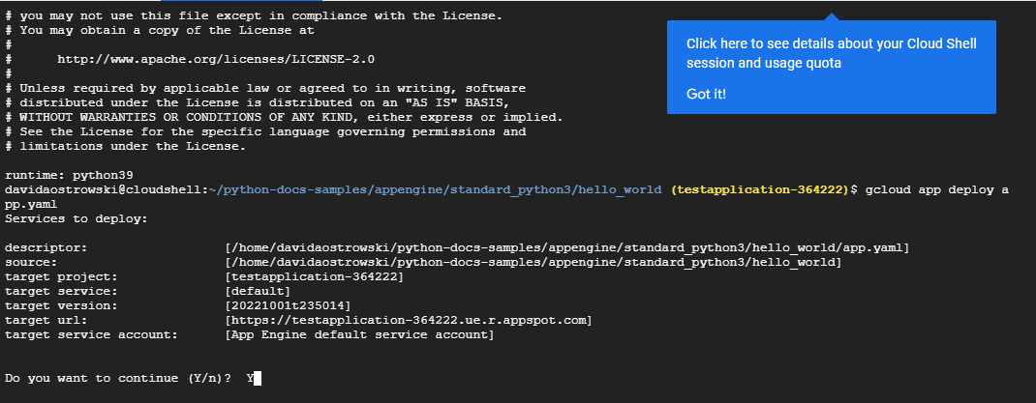

Slide 25
[https://testapplication-364222.ue.r.appspot.com]
Setting traffic split for service [default]...done.
Deployed service [default] to [https://testapplication-364222.ue.r.appspot.com]

Slide 26
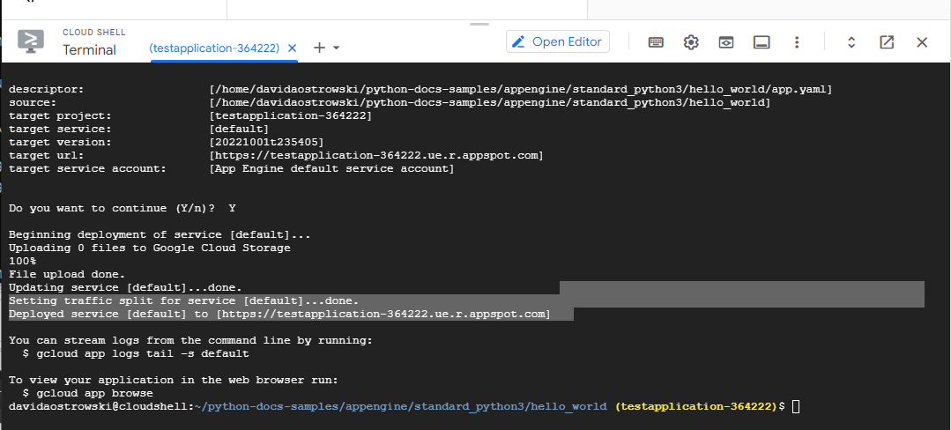

Slide 27
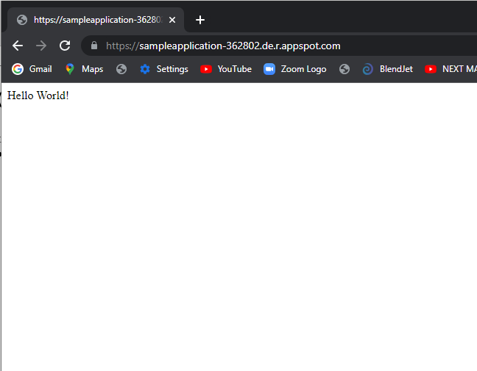

Slide 28
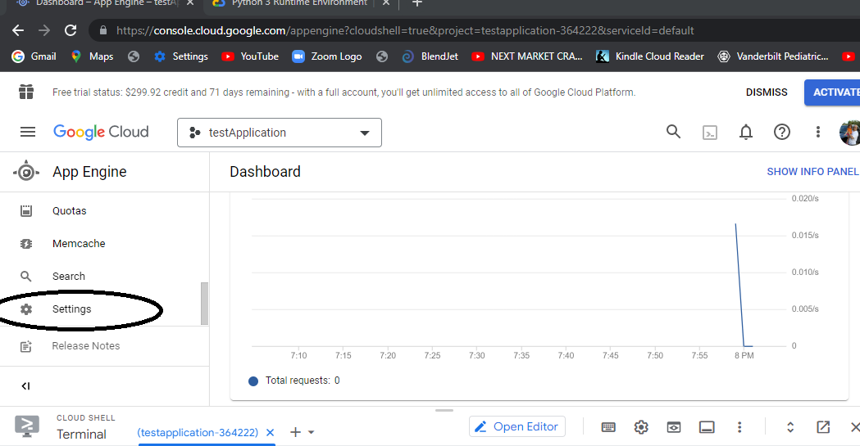

Slide 29
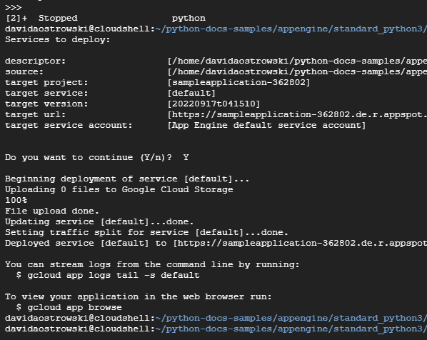

Slide 30
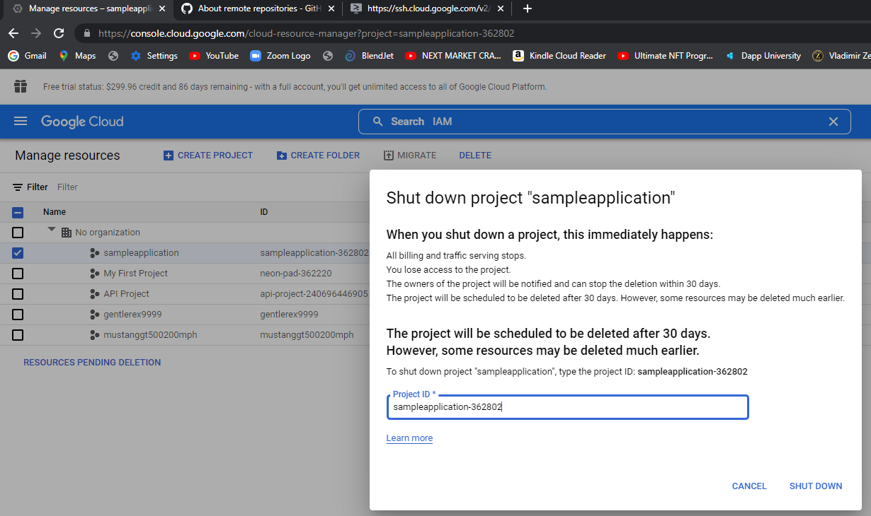

Slide 31
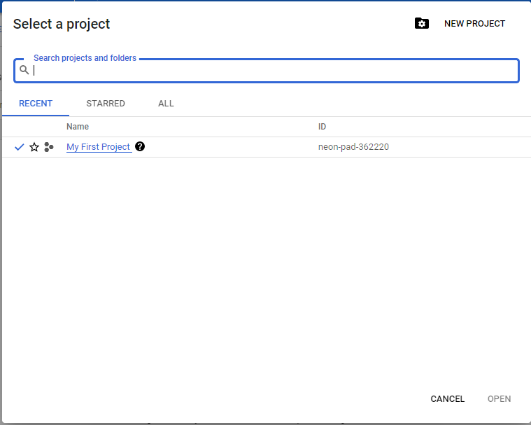

Slide 32
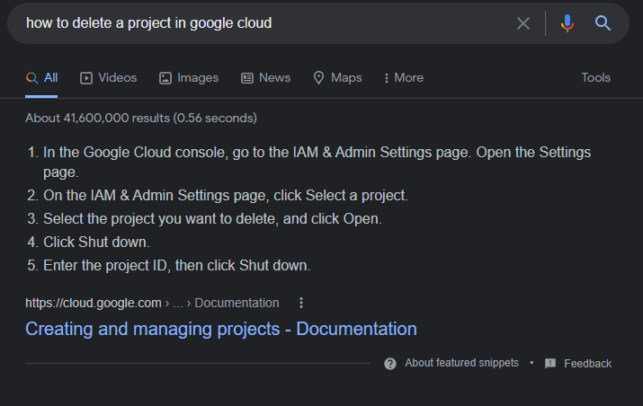

Slide 33
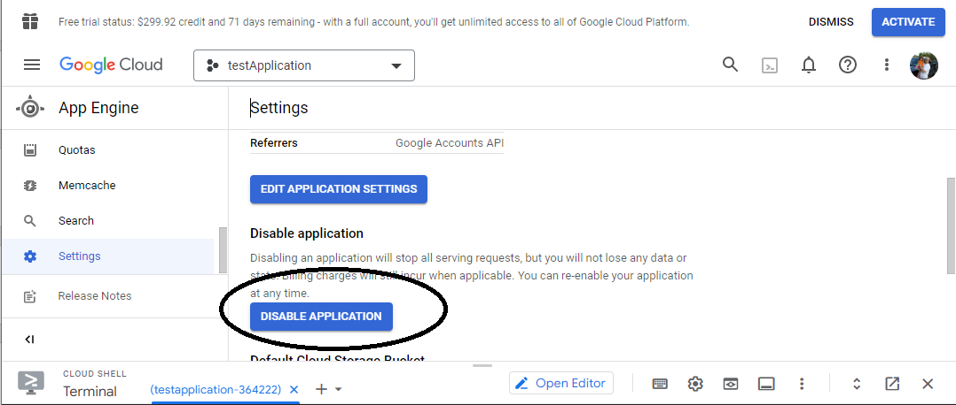

Slide 34
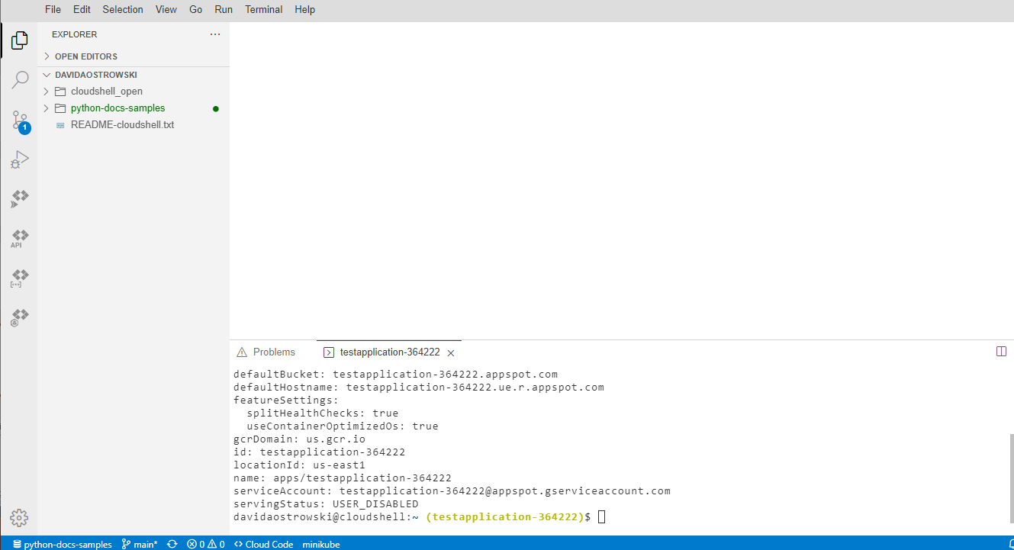

Slide 36
If prompted you may need to attach to a billing account.

Slide 37
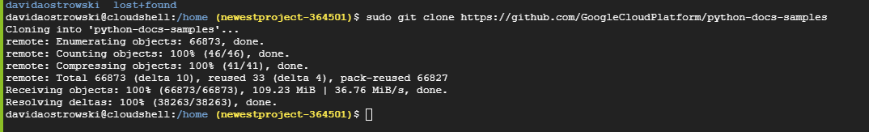

Slide 38
https://stackoverflow.com/questions/56126481/gcloud-error-gcloud-app-deploy-permissions-error-fetching-application

Slide 39
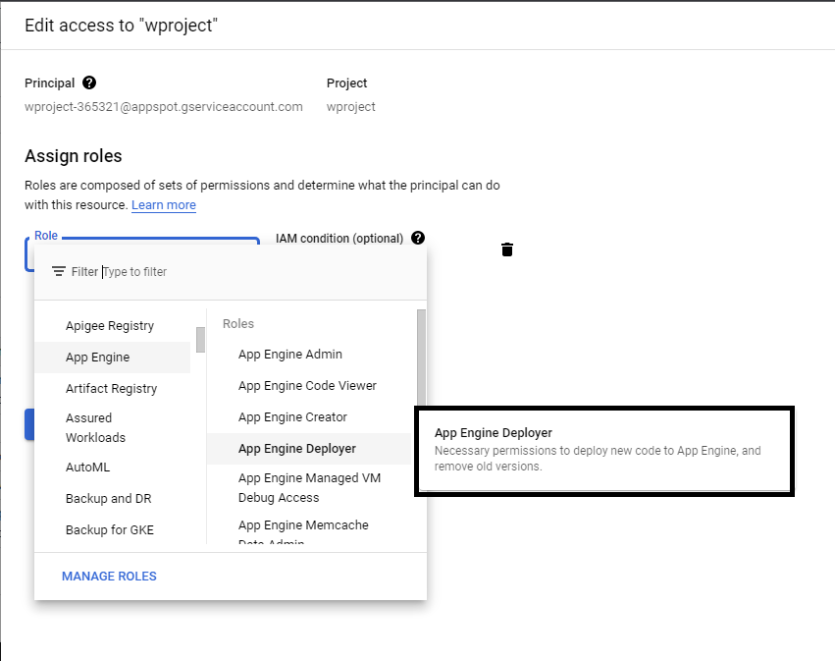

Slide 40
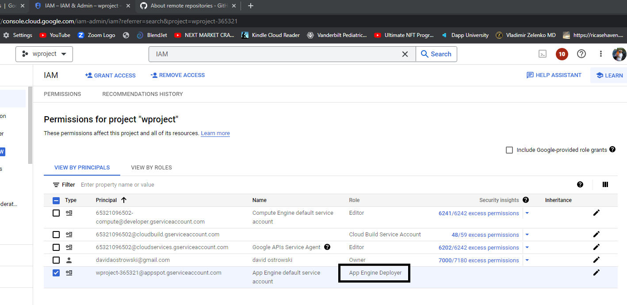

Slide 41
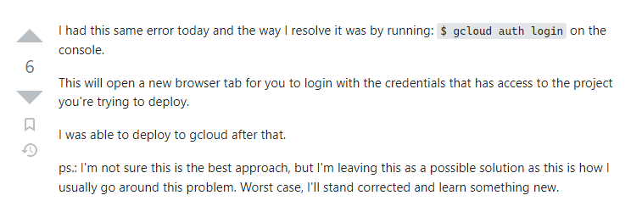

Slide 42
https://stackoverflow.com/questions/45831215/google-cloud-deployment-user-disabled

Slide 43
